Slide 1


E-COMMERCE PLATFORM FOR TRIBAL PRODUCTS
Indi Tribes
www.inditribes.co.in

Slide 2


Ministry Name: Ministry of Tribal Affairs
Problem Statement: E-Marketplace wherein tribals can promote, market and sell tribal produce such as handicrafts, arts paintings, minor forest products etc. on line with provision of delivery, e-payment and promotional discounts.
PS. No. – DN260
Team Name: Server Monks Team Leader Name: Soham Roy
Nodal Center: Institute of Engineering and Technology, Ayodhya, Uttar Pradesh

Slide 3
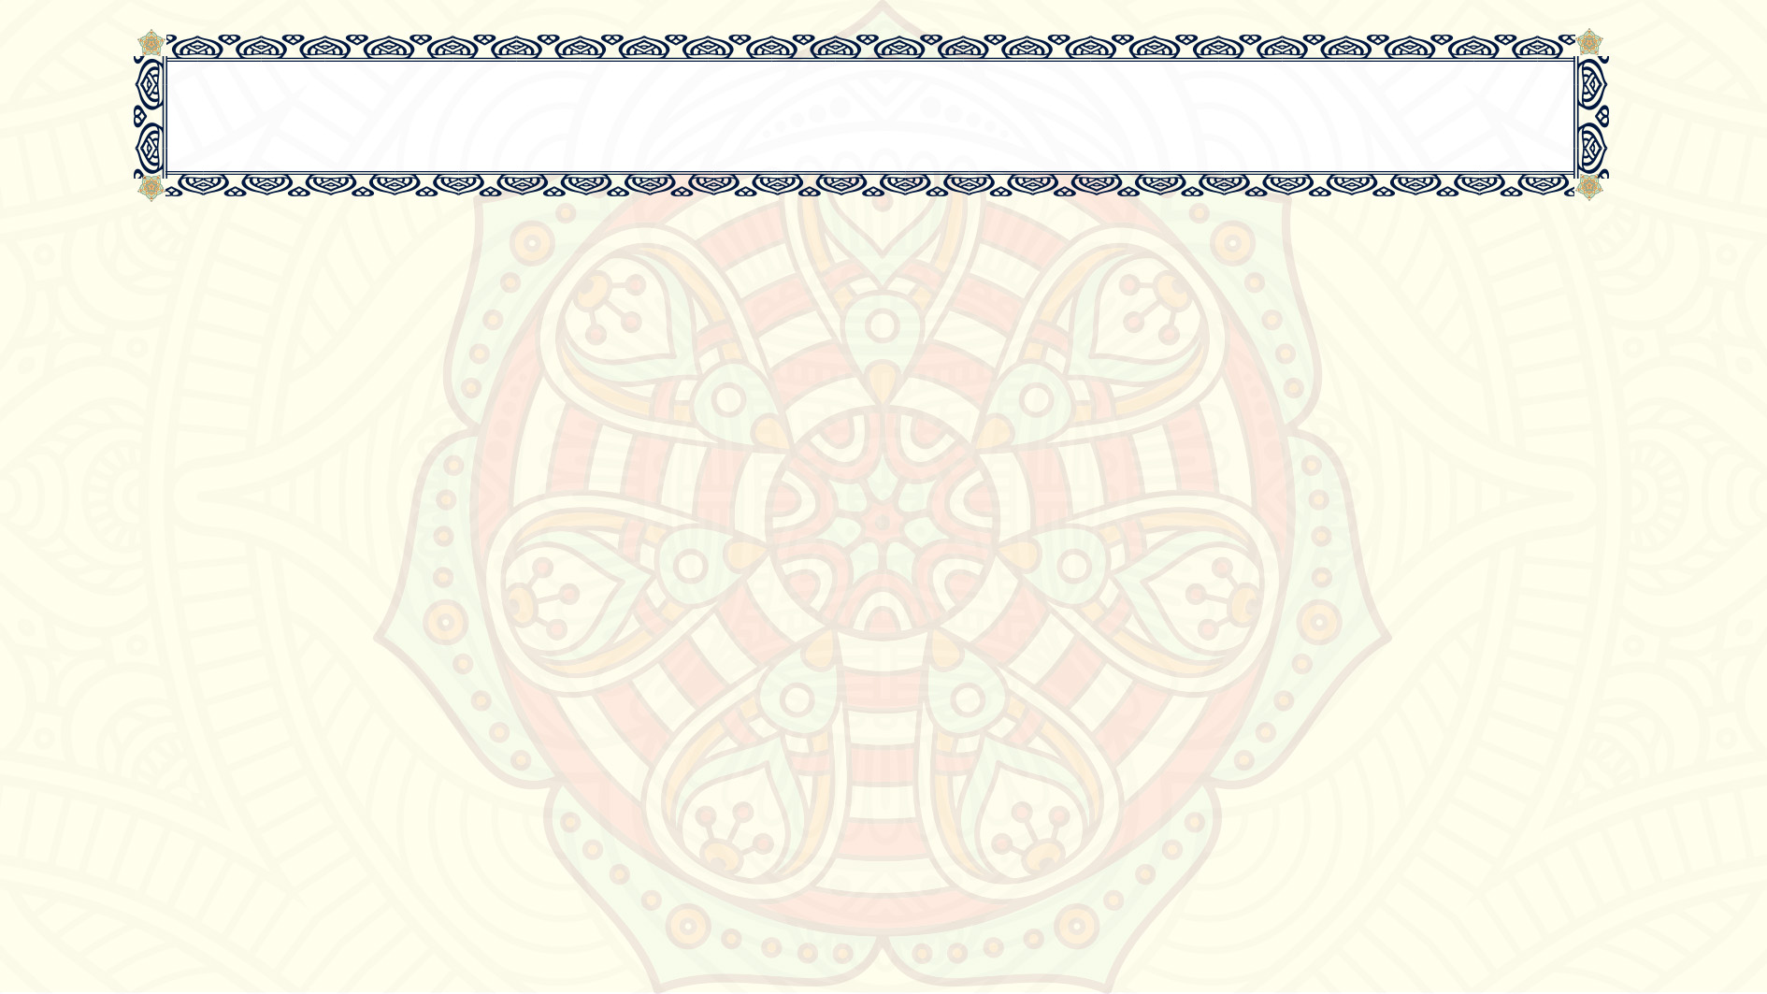
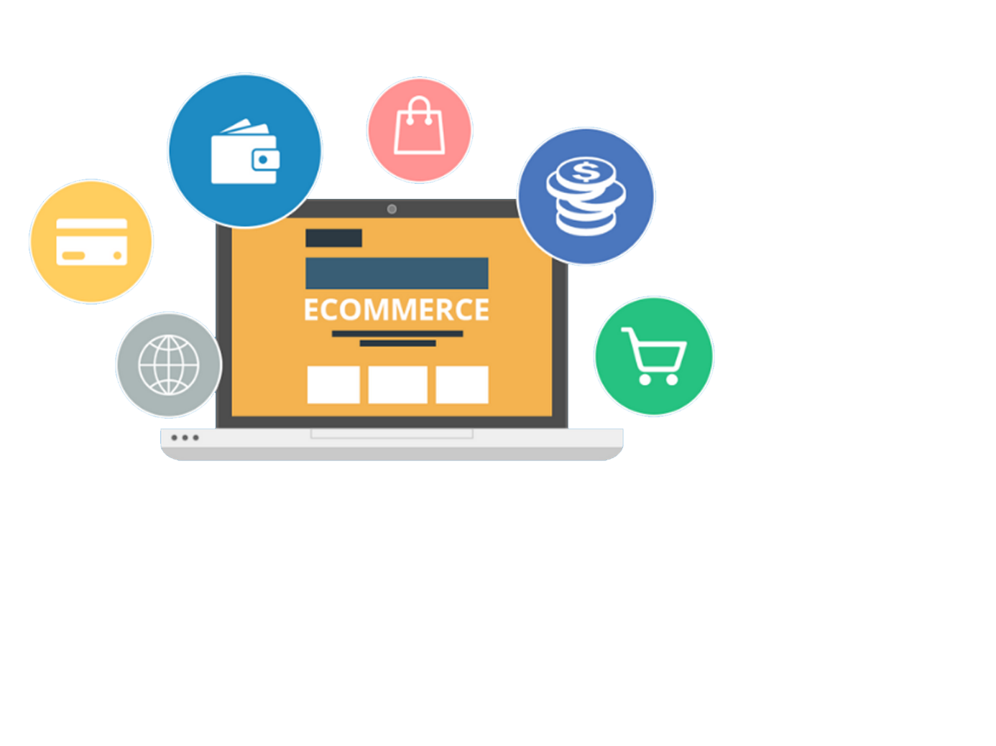
What is Indi Tribes?
Indi Tribes is an E-marketplace developed for the tribals where tribal artisans across the whole country will be able to sell their products at the click of a mouse. This would be a great initiative to make the tribals self-sufficient and monetarily independent.
This platform will help all of us purchase tribal products directly from the website without going through a lengthy process of actually visiting that particular place to buy a specific artefact.
With more and more people going online to meet their various needs - be it for business expansion, shopping and communication, Covid-19 crisis, an important strategic push has been to adopt a digitization drive to map and link its village-based tribal producer.

Slide 4

How this platform will benefit the tribes?
According to new research, e-commerce is vital for India particularly for tribes located in rural areas as each native e-commerce business could spark an additional $1 million in the economic activity of India
An online platform where the tribals living in rural areas who do not have a lot of facilities can promote and sell their handmade products.
Anyone from any part of the country would be able to buy these products via an E-Commerce website , thus providing a boost in the sales of these tribal products.
This step would be beneficial for the tribals as well as the Government because it provides a boost to the economic activity in the Country .

Slide 5

LIST OF BASIC FEATURES
OF THE E-COMMERCE PLATFORM

Slide 6

HOMEPAGE FEATURES LIST
1. Search Bar
User can search product by the Product’s name, or any word present in the product description, the tribe who made the product, the location of that tribe, etc.
2. User-friendly navigation
A clear navigation bar improves the User understanding of our site.
3. Customer Login
Our site should definitely let the customers register and login. It’s best to place this on the top bar for easy access.
4. Shopping Cart

Slide 7

HOMEPAGE FEATURES LIST
5. Featured products or Best selling products
We will manually add featured products or automate the process to show a list of best selling products.
6. Newsletter Signup
As a modern ecommerce site, we should have a newsletter signup form that collects our customers’ email addresses. We can send them special offers and inform new product arrivals.
Indi Tribes is designed in such a manner that even people with color blindness and dizzy vision will be able to browse through our marketplace without much difficulty

Slide 8
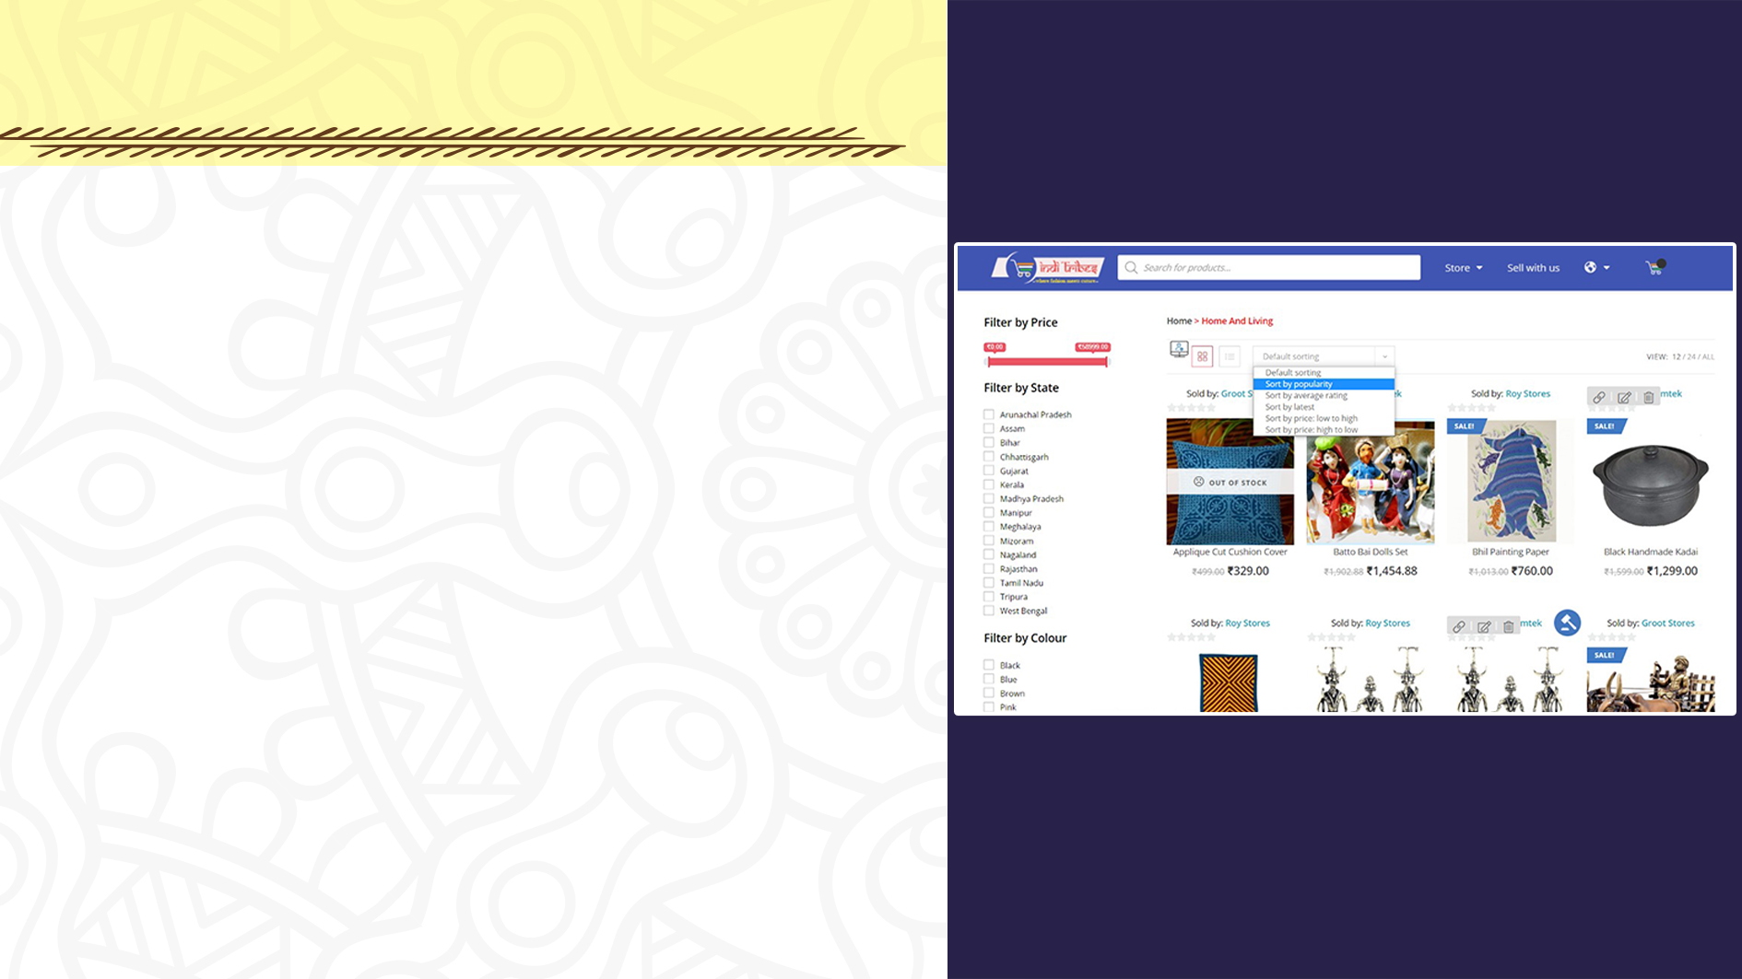
CATEGORY PAGE FEATURES LIST
Breadcrumb Navigation
Breadcrumb navigation helps the visitors to easily browse through product categories.
Product Filtering and sorting
Product filtering allows customers to filter products based on different attributes. For example gender, size, color, Tribe etc. as its filtering options. The sorting allows viewing products on ascending or descending order of price and arrival.

Slide 9
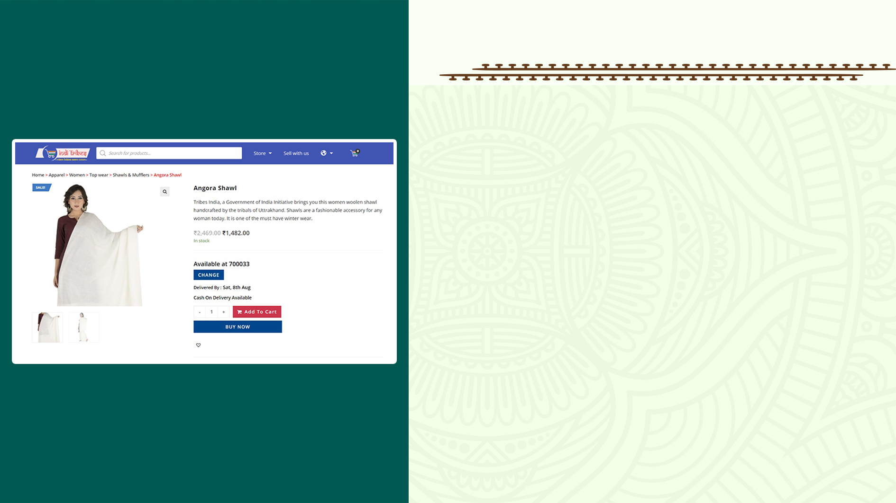
PRODUCT PAGE FEATURES LIST
A field to change purchase quantities
Just below the product price, there will be an option to change the product quantity. That way, the customers can easily select the number of items they want to buy.
Product Variables / Attributes
Some variables like colour and size of a physical product should be selectable right from the product page.
Add to Wish List
Wish list enables the customers to store a product if they want to buy that later.

Slide 10

PRODUCT PAGE FEATURES LIST
Estimated Delivery date:
On the basis of the address entered by the user , an estimated delivery date shall be displayed by calculating the distance between the delivery address and the warehouse location. This will help the user to know whether the product is being delivered before the date of use .
Stock availability on a particular pincode :
This feature will help the user to know whether a particular item will be available at the entered pincode or not.

Slide 11

CHECKOUT PAGE FEATURES LIST
1. Shopping Cart Details
2. Have an option to change the quantity or remove items
3. Final Price
Shows the total price the customer has to pay for the current order.
4. Allow items to be saved for later
If for any reason a customer doesn’t want to go through the payment process at this stage, provide them with a way to store their cart in case they want to come back later.

Slide 12

CHECKOUT PAGE FEATURES LIST
5. Billing address and Shipping address
Wish list enables the customers to store a product if they want to buy that later. A compare feature can also be very useful for them.
6. Shipping method (offer low shipping cost)
Our customers will find multiple shipping options very convenient. There should be at least one low-cost shipping option.
7. An area to punch in promo codes
Our business may occasionally provide promo codes to customers. This field is where customers may apply the promo codes to get discounts or other privileges.
8. Acceptance of all payment methods
Our ecommerce site should accept most of the payment methods that are popular among our customers.

Slide 13

ORDER COFIRMATION PAGE – E-MAIL
After confirmation of the order an email will be sent to the customer which will contain
Signed Email: The email will be duly signed by the one authorized.
Link to The Product Page: A link will be provided in the email which will directly open the product page.
Order Status: A link to check the shipment status of the product will be provided in the email.
View/Manage Order and Cancel Order buttons: Links to the website to vie/manage order and cancel order.
Details on the tribes: The email will contain a complete detail of the tribe producing the particular product and would ask the customer for a donation for the upliftment of the tribes (as an NGO service).

Slide 14
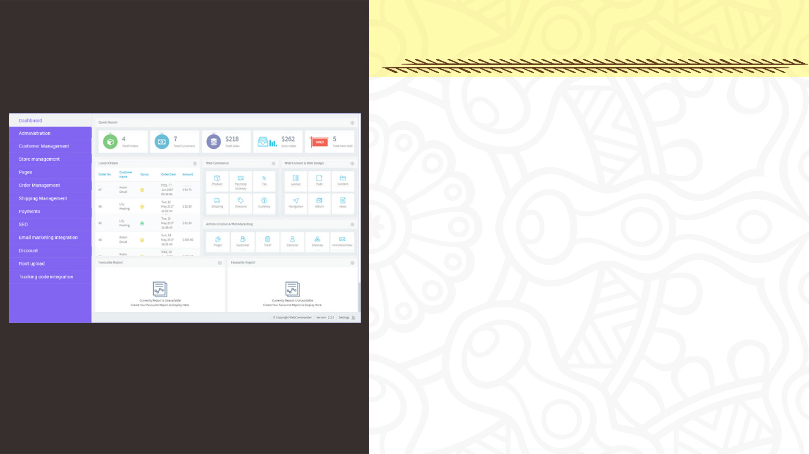
BACK-END FEATURES
Administrator Management
Usually, a website will have a number of managers. We as the owner should be able to decide who can access which part.
Store Management
Product specifications, like – categories, colours, descriptions, sizes etc. should be very easily editable from the backend of our site without assistance from a developer. We should also be able to select the featured products.
3. Order and shipping Management
At any certain time, an ecommerce site will obviously have lots of orders in the process at different stages. It also needs to handle different shipment processes. All of these should be easily manageable from backend.

Slide 15

BACK-END FEATURES
4. Dashboard/reporting tools
The dashboard should allow us to view all ecommerce metrics in a summarised way. It should be customised to meet our specific business needs.
5. Customer Management
Managing customer orders and their account information is a mandatory feature. It’s better to store customer’s search history too. That may help us to provide personalised offers to frequent visitors.
6. Content Management
The pages of our site, their layouts, our blog and other contents of our site should be manageable from the backend without any manual change in the code of the site.

Slide 16
BACK-END FEATURES
7. Payment, taxes and location Management
Our site’s backend platform should be easily able to manage different payment processes,
8. Email marketing integration
Usually, backend management platforms can have email marketing features integrated into it. Sorting and storing customer emails and sending personalised emails are very useful to increase conversions.
9. Discount and promotion Management
Applying varying discounts and introducing different promotional offers becomes a lot more hassle free if our backend provides these facilities.

Slide 17

MISCELLANEOUS FEATURES LIST
1. Browser compatibility
The site is properly rendered in all major browsers.
2. Responsive design
It should go without saying that designing responsive website is a mandatory skill for any Melbourne website. Regardless of device size, our site should be flexible enough to provide the best user experience.
3. Multilevel security
Security is always one of the most important aspects of any ecommerce business. Apart from SSL certificates and PCI compliance, our site has strong firewall and layers of security on login and contact forms. We have cloudflare CDN and our site follows all the guidelines of OWASP security features of a website.
4. Automatic site backup
Our site should be automatically backed up to prevent any accidental mishap. For an ecommerce site, it’s very important to always remain live.

Slide 18

Know About the Tribes
A number of pages have been added describing the heritage and culture of all the tribes of India. It will help customers understand about the traditions and specialty of the tribes

Slide 19
LIST OF SPECIAL FEATURES
OF THIS E-COMMERCE PLATFORM

Slide 20
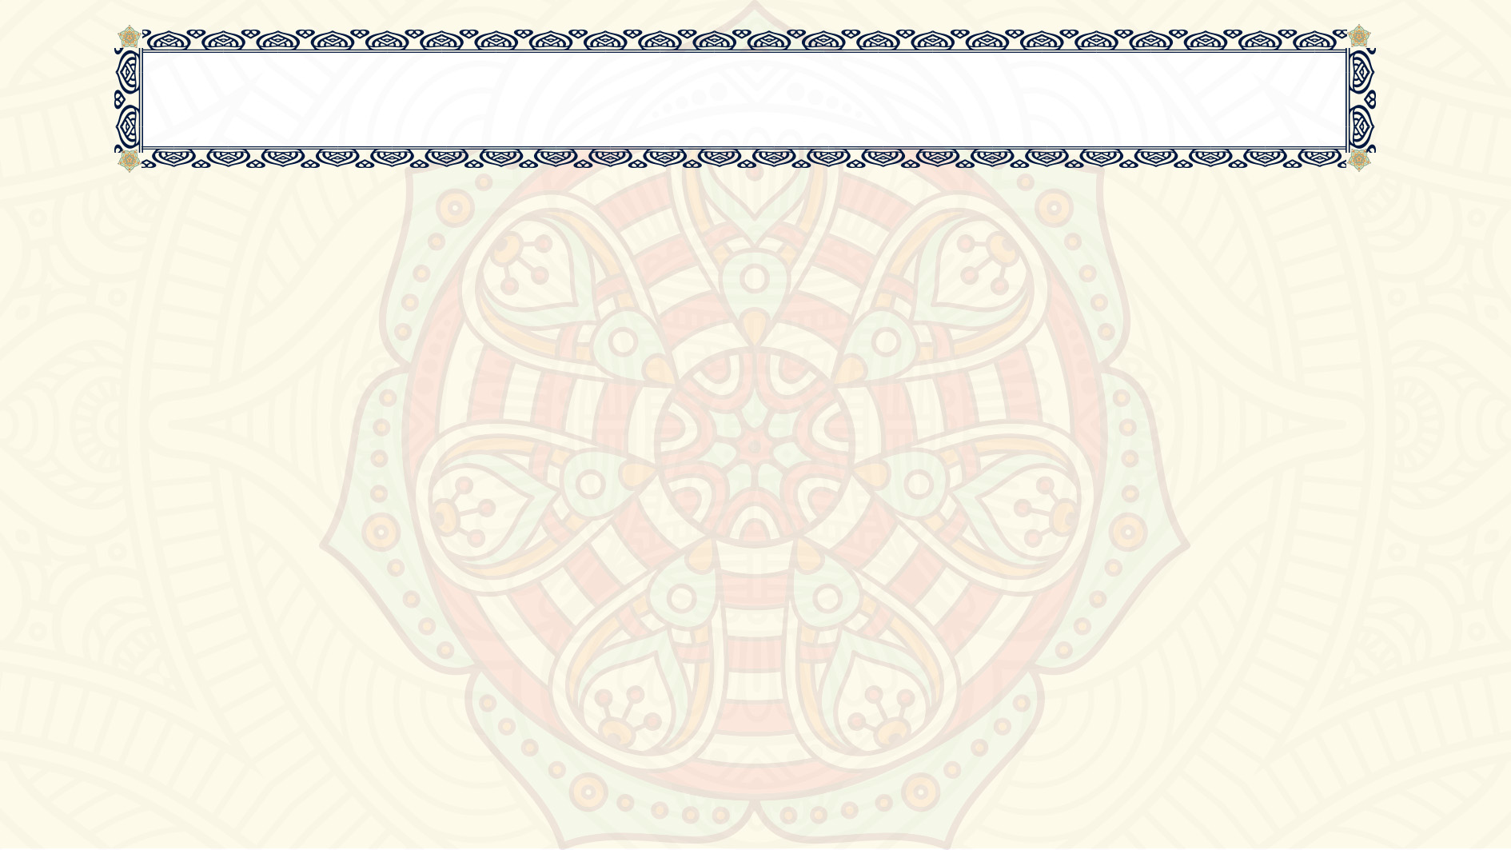
SPECIAL FEATURES
Sell on Indi Tribes – Simplified Registration Process for Tribal Vendors
Vendor resources and tutorials have been added to help the tribal vendors at each and every step.

Slide 21
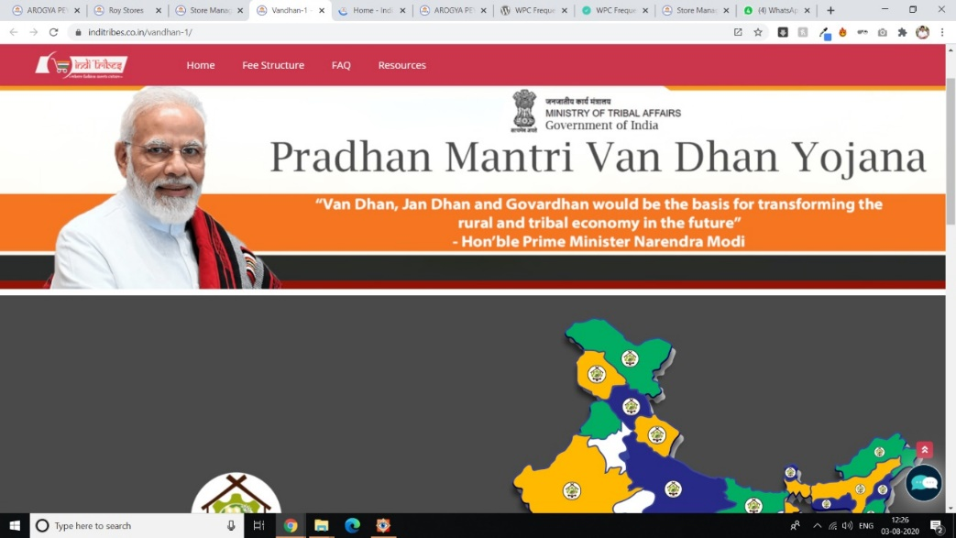
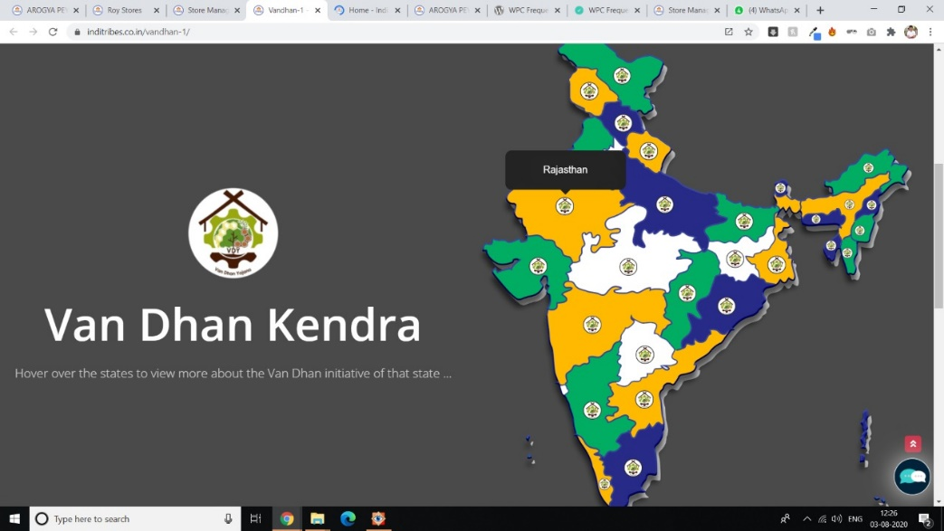
SPECIAL FEATURES
Van Dhan Yojna - The scheme will be implemented through Ministry of Tribal Affairs as Nodal Department at the Central Level and TRIFED as Nodal Agency at the National Level.
Tribals facing any problem can contact their nearest Van Dhan Kendras for any help and support .

Slide 22
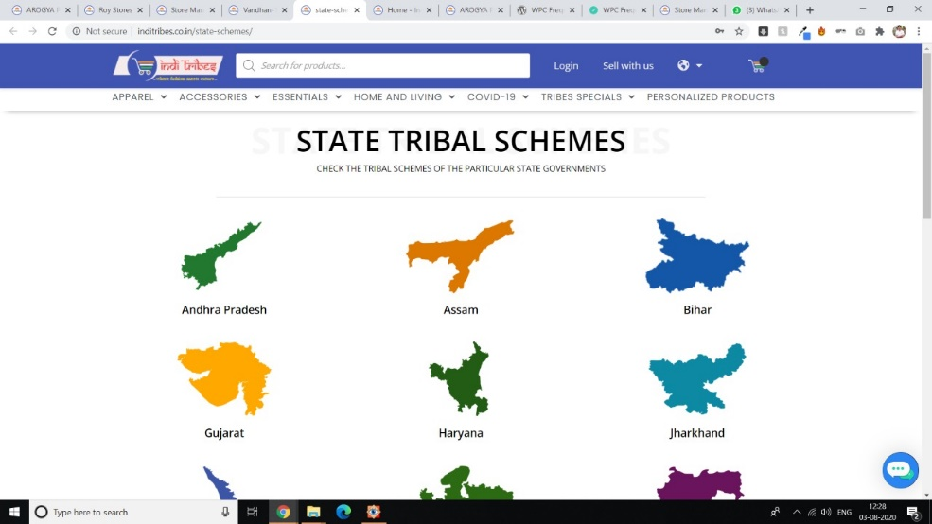
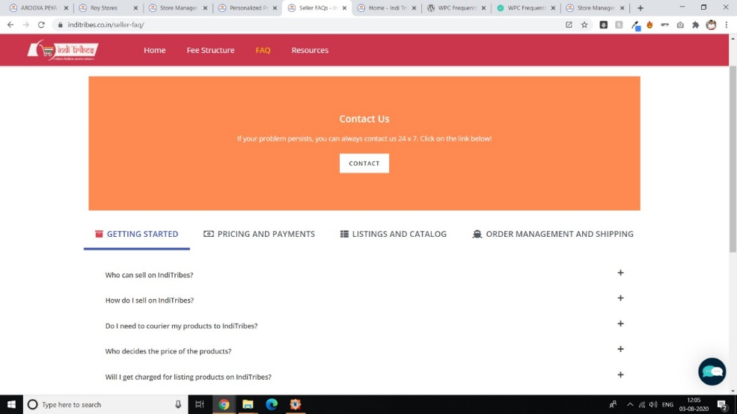
SPECIAL FEATURES
State tribal schemes have been added to further help people learn about the state schemes and policies
Almost all the queries and questions have been added and answered in the FAQ page for the benefit of the Vendors.

Slide 23
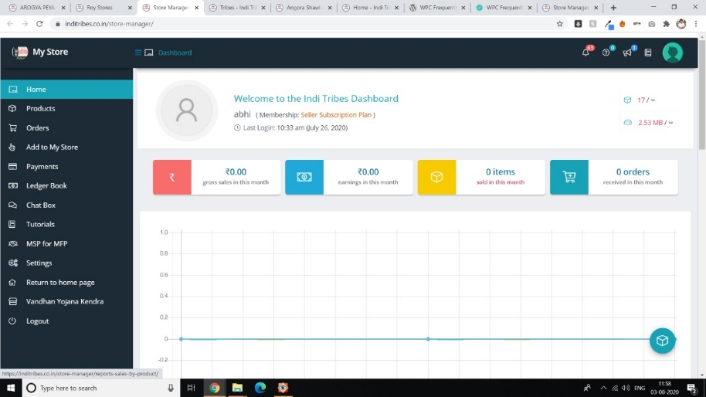
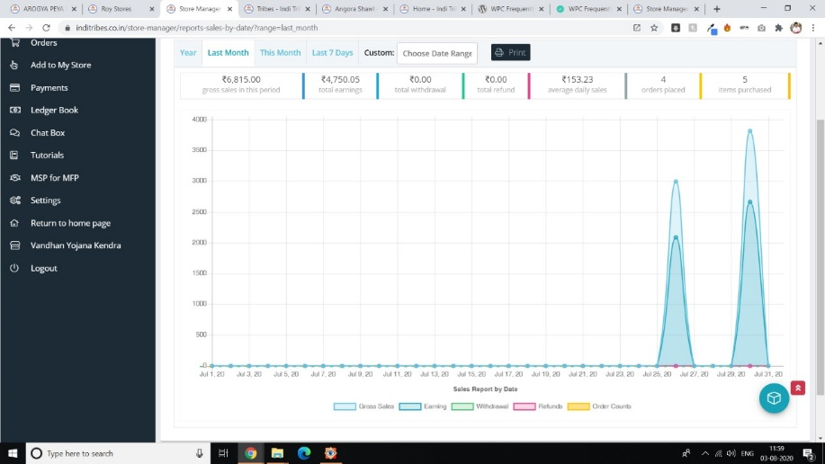
SPECIAL FEATURES
Vendor Dashboard
Easy monitoring of sales statistics
Adding new product made easy
Change order status with just one click
Automatic withdrawal on 1st of every month
Van Dhan Kendra Locator
Responsive Android facility integrated vendor dashboard made easily accesible

Slide 24
SPECIAL FEATURES
Coagulation of Sellers. We have implemented a chat module so that 2 vendors can communicate and agree for coagulation according to their terms living in any part of the country. By using single product multi-vendor scheme quantity of a product will be shared by 2 vendors. Which will give both the coagulated sellers equal chance of selling both the product.
24*7 store assistant facility to help customers find products easily
Tracking details will be sent to customers on My orders as well as
via email

Slide 25
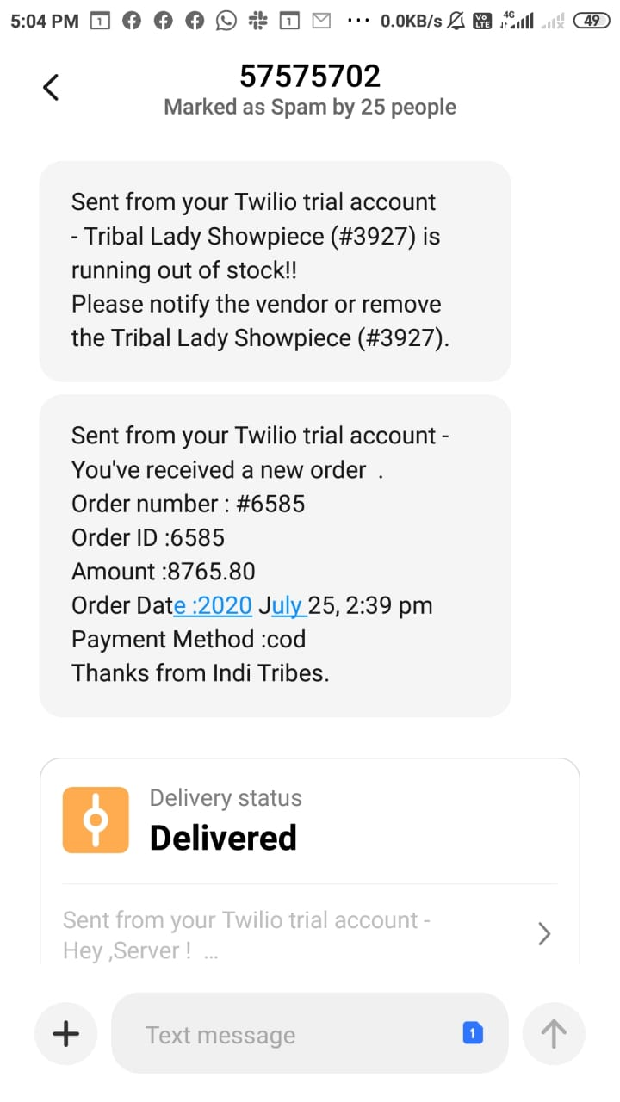
SPECIAL FEATURES
Vendor needs to register and upload their inventory once using Internet facility and after that they can carry on their business via Mobile SMS notifications. This ensures that even vendors with low 2G connectivity and old fashioned mobile phones will also be able to sell their products on our marketplace

Slide 26
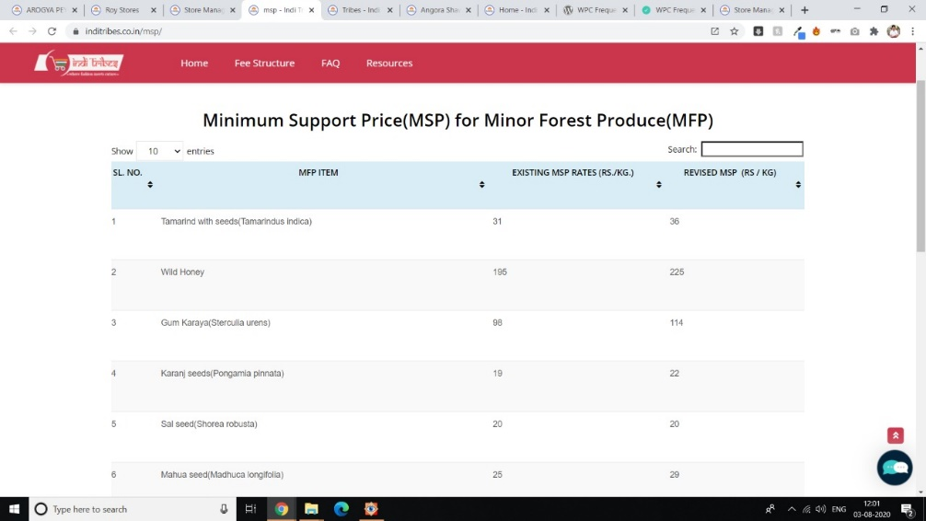
SPECIAL FEATURES
Minimum selling price for Minor forest products
This was a measure towards social safety for MFP gatherers, who are primarily members of the Scheduled Tribes (STs) most of them in Left Wing Extremism (LWE) areas.
However, MFP production is highly dispersed spatially because of the poor accessibility of these areas and competitive market not having evolved. Consequently, MFP gatherers who are mostly poor are unable to bargain for fair prices. This package of intervention can help in organizing unstructured MFP markets.

Slide 27
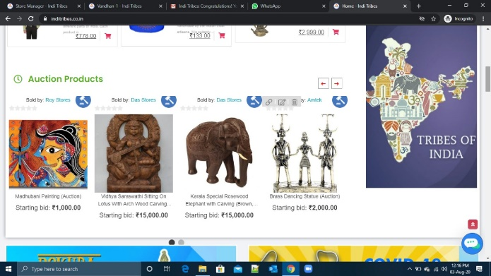
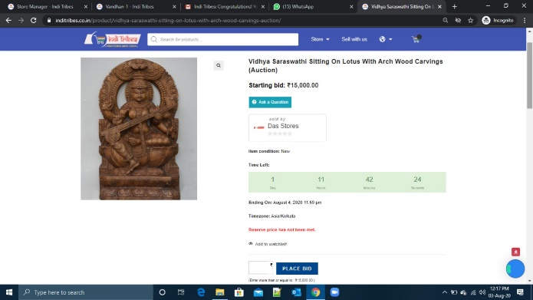
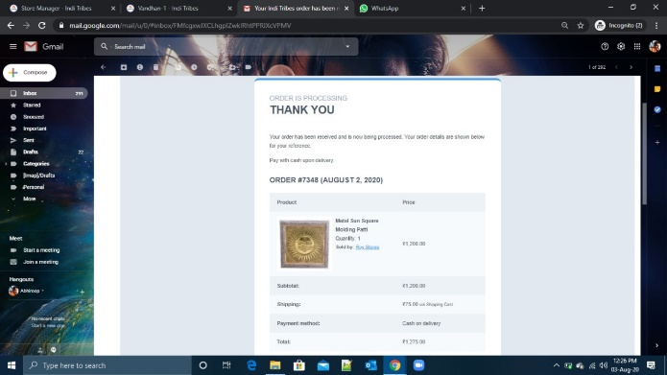
SPECIAL FEATURES
Auction of a single product. A single product can be placed on auction by the admin. It will notify the vendor whose product is placed on auction. The admin needs to set up the time slot for which a products bidding will take place. He needs to set up a minimum bidding price, incremental of bidding price. We have implemented email notification to the bidder once they bid when another bidder overrides his/her bid the will get an overridden mail. We have also added some of auction panels in accounts section of the bidder, where they can see the highest bid and keep watch on it. We are also planning of implementing SMS notification to the bidders can be notified with more ease.

Slide 28



SPECIAL FEATURES
Mobile & E-mail verification
An OTP/verification mail will be sent after a user signs up, in order to verify the registered user. This is done for security reasons.
Minimizing Vendor Registration:
For any bulk orders there will be a separate page to contact the website administrator.
Code Optimization:
We have minified HTML,CS and Javascript files.We have optimized the database so that querying becomes fast.We have included Cloudflare Server for getting media images from the server nearest to the viewer,making the website very fast in delivering content.We have also used page caching so that page loads very fast.

Slide 29


SPECIAL FEATURES
Front page for promotion of products :
There may be times when promotion of certain products or information about the sale on some items have to displayed on the front page . Policies need to be decided for such promotions in order to maintain a fair and equal opportunity for all the sellers .
Together Bought With:
This feature shall provide the user options about the products(he/she didn’t think of) that are usually bought along with the item he/she is buying. For example recommending a customer to buy the mobile cover as well as the screen guard along with the purchased mobile.

Slide 30


SPECIAL FEATURES
Low Stock notification:
When the number of stocks of a particular product will get low a notification will be sent to the warehouse administrator to refill the stocks from the tribal manufacturers.
Product Authenticity Check :
There will a piece of paper attached to each and every item which will have a number and seal of authenticity.
Upon entering the number in the verification page of our website it will confirm that the product is a part of our forum.
Which will confirm that it is not a duplicate product nor it has been misplaced.
If the product is a forest resource then we will also show when it was collected

Slide 31
SPECIAL FEATURES
Provision for selling Personalised Products:
Customer will select a product which they want to be customized.
They have to select within the options available for customization.
A notification will be sent to all the sellers if they can provide that product.
We will calculate the minimum cost of that product by calculating (product cost and delivery cost) and will be emailed to the user along with the estimated delivery date.
On getting confirmation from the customer further work will proceed.

Slide 32
ADDITIONAL FEATURES
Automate sales report creation and distribution
Integrate email marketing software for re-marketing to the customer
Automated stock level notifications
Automatic creation and distribution of purchase order requisitions when an order depletes stock levels below agreed thresholds
Automated creation and distribution of stock reports
Stock receipt notifications (email/SMS)
Low stock notifications (email/SMS)
Customer portal
QR scanner system integration for checking product authenticity

Slide 33
ADDITIONAL FEATURES
A Basic recommender system has been implement which promotes items which are related to the items which is currently being browsed. The items which are suggested follow two main sales strategies: Cross sales : An item is suggested which almost of the same attributes as the item being searched. For example if an edible ingredient such as tea is being searched, another edible ingredient such as honey might be recommended Up sales: When the user is looking for an item which certain attributes, he/she might get suggested another product of the almost similar attributes but with more selling price. For example when someone is looking for a Kurta, they might get another higher quality Kurta recommended

Slide 34
TECHNOLOGY STACK
OF THIS E-COMMERCE PLATFORM

Slide 35






TECHNOLOGY STACK
Front-end technologies
HTML5, CSS, JavaScript
Content Management System (CMS)
Wordpress
Back-end technologies
MySQL Database
PHP
Payment Gateways
RazorPay / BHIM UPI
Communication Api
Twilio

Slide 36
WORKFLOW
OF THE E-COMMERCE PLATFORM

Slide 37
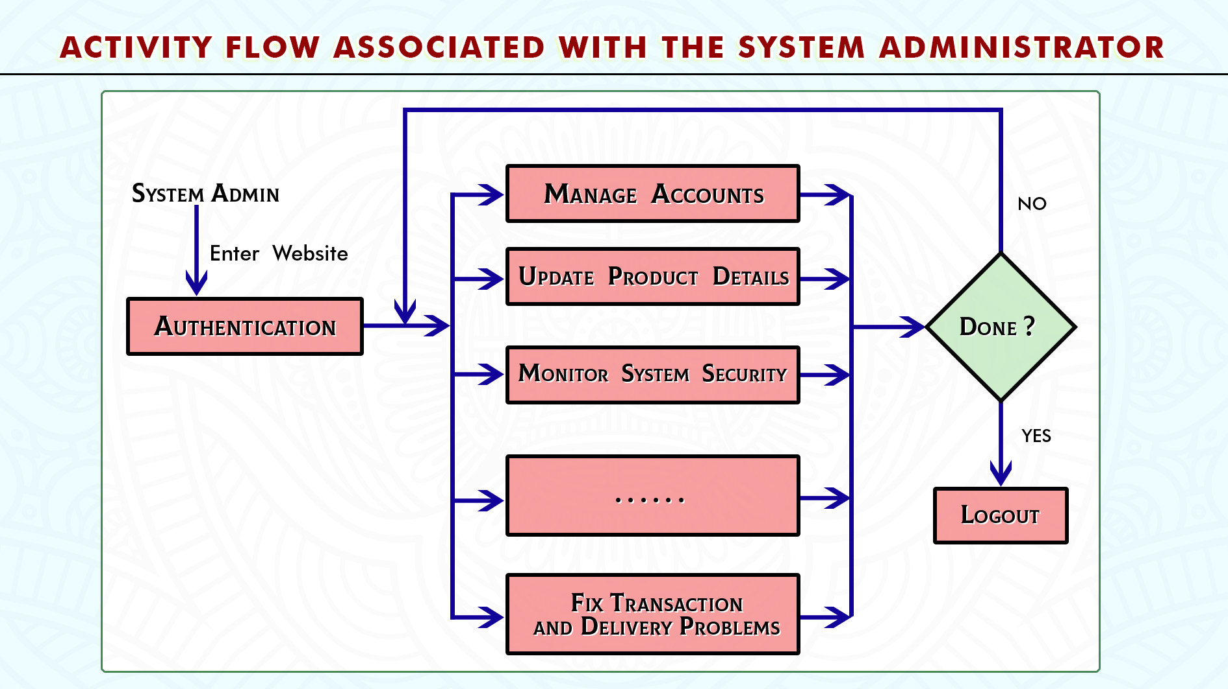

Slide 38
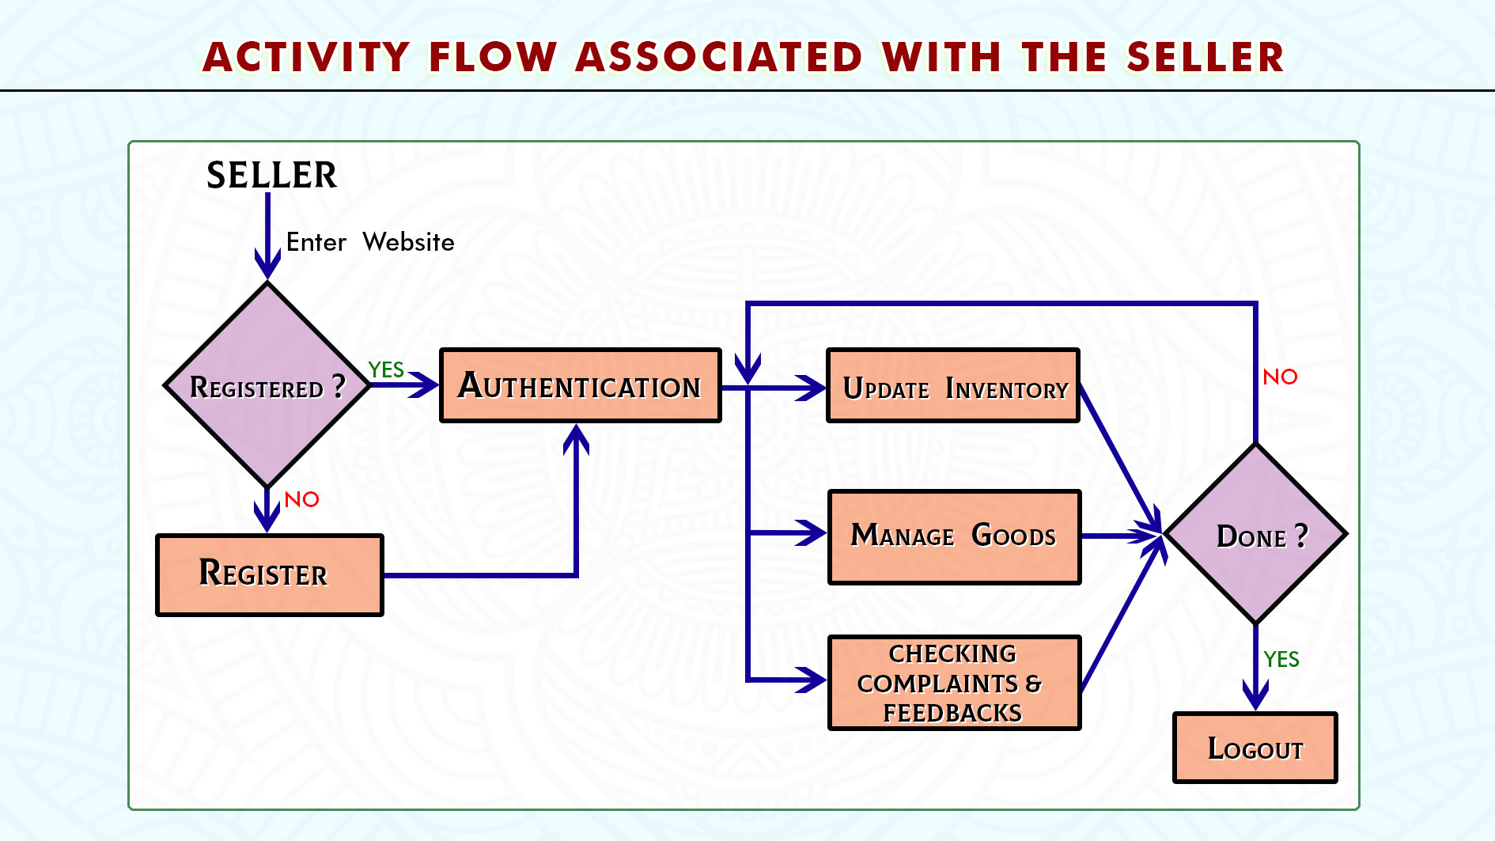

Slide 39
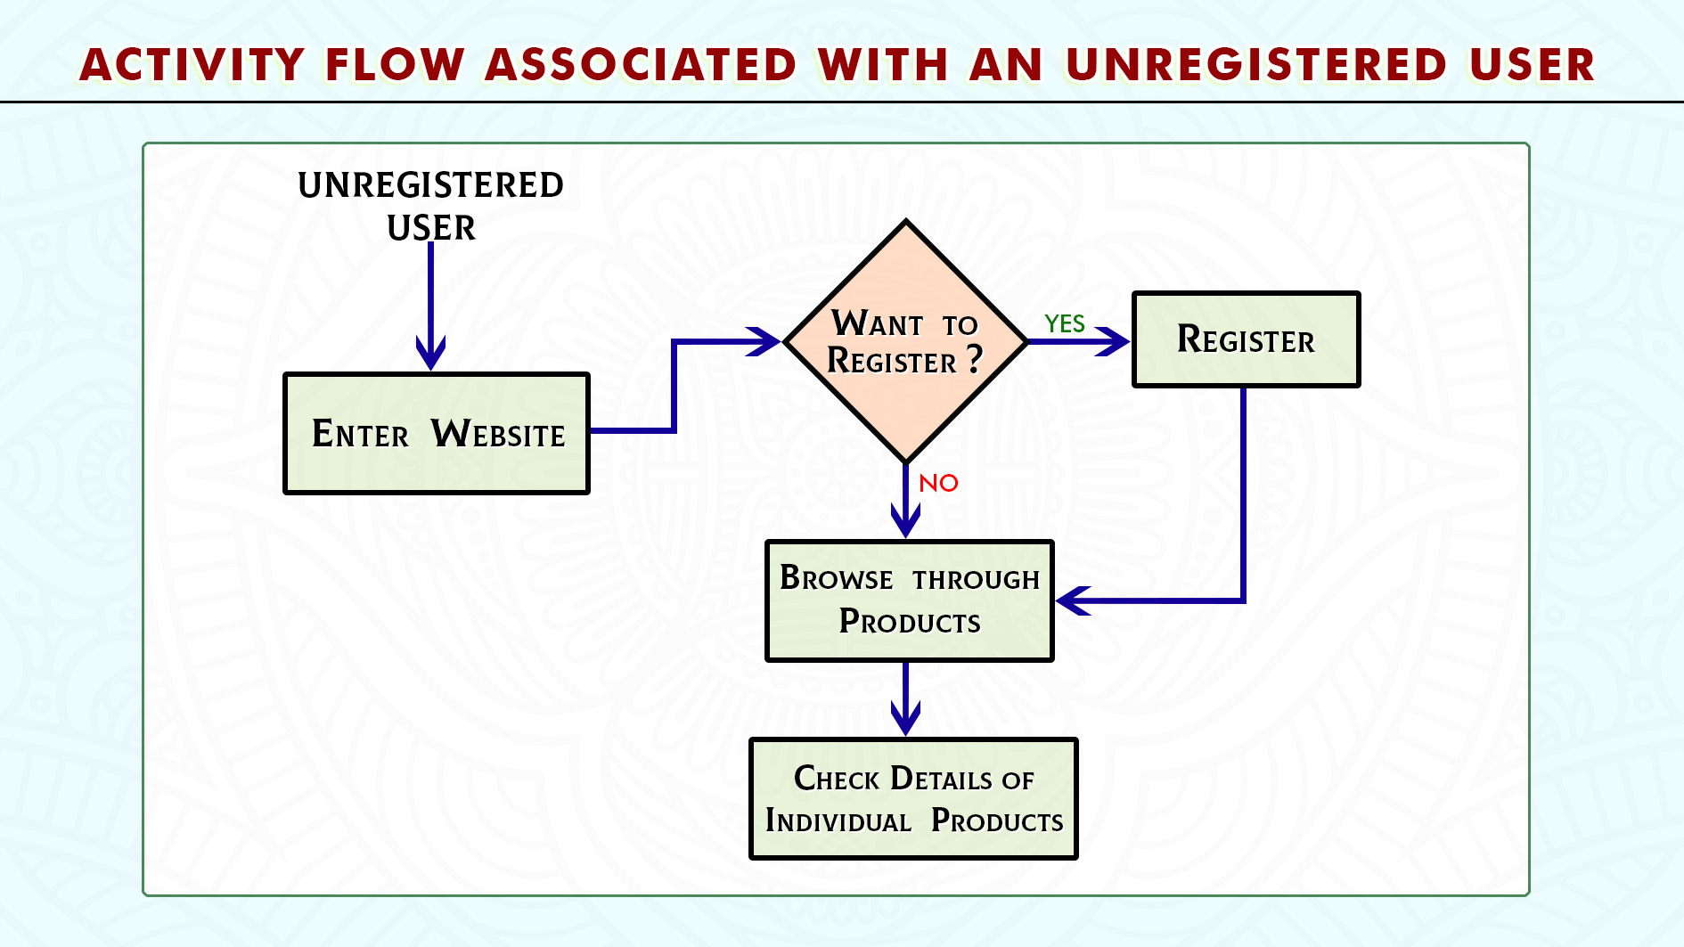

Slide 40
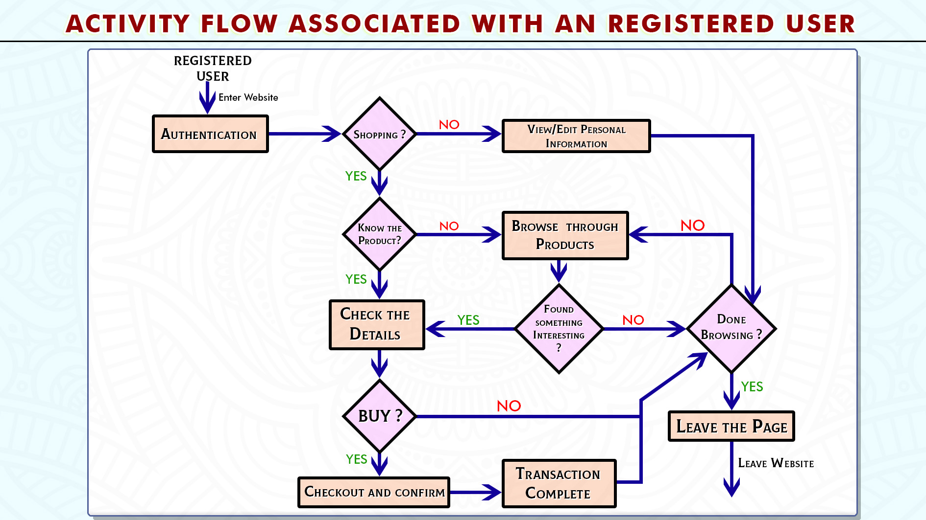

Slide 41

FINAL THOUGHTS
And
CONCLUSION
A platform connecting urban people with tribal people

Slide 42


Future Aspects
Platform to shed light on the unrecognized talents of the tribal people.
A source of economic income
Introducing tribal heritage to the urban world.
Economic benefits.

Slide 43

CONCLUSION
Ease of use of the application stands out
Standard E-commerce functionalities guaranties proper transactions.
Can be a source of money for poor tribal people.
Can shed light on historical significance of the products which are being sold.

Slide 44


